Slide 1






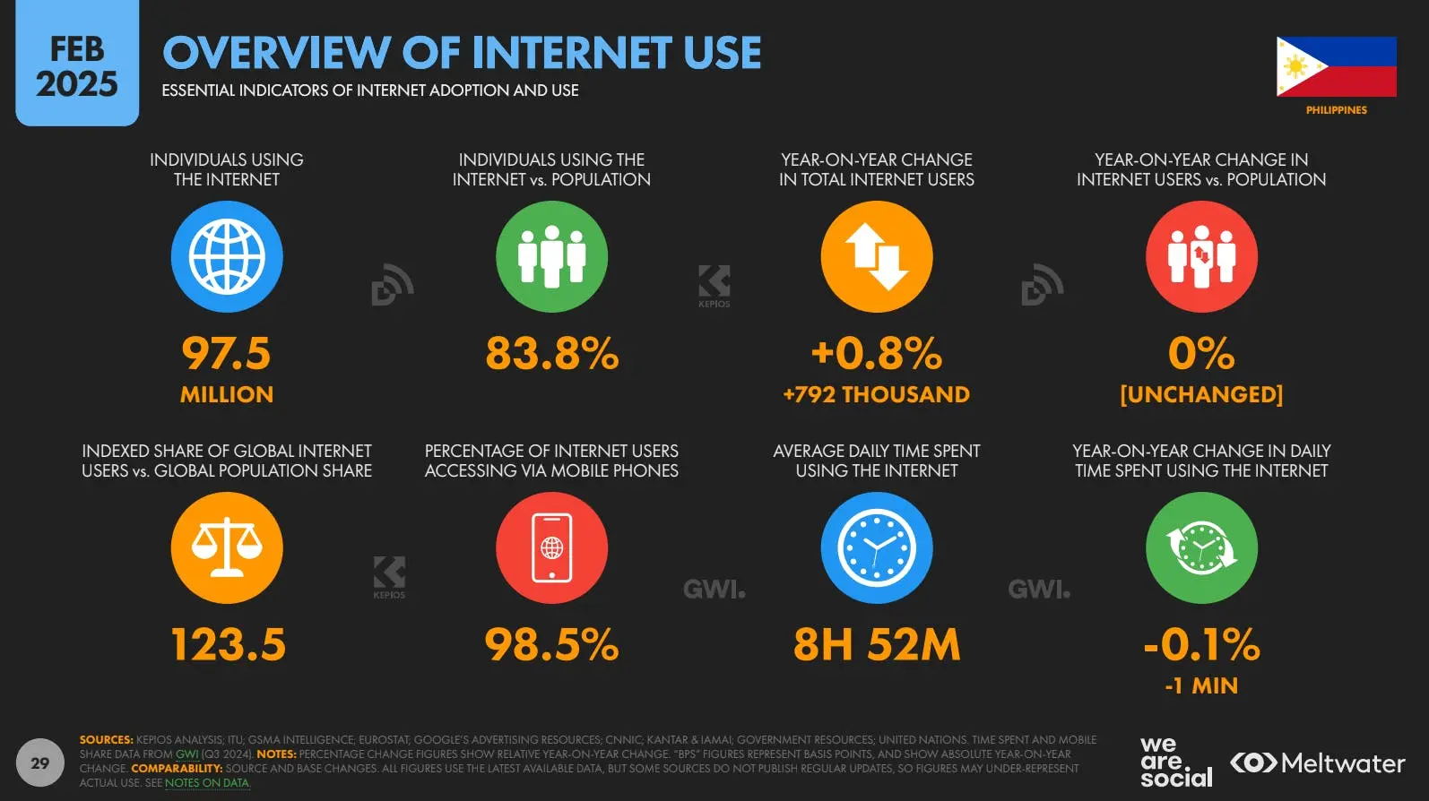

The Internet is deeply integrated into the average Filipino’s daily life; using this for work, social needs, entertainment, among other mundane things.
UP INTERNET FREEDOM NETWORK | DRAPAC 2025

Slide 2
Like any form of media however, authorities are growing more aggressive in hopes of monitoring and regulating our use of Internet to the point that they trample on our basic rights and make us more vulnerable.
Examples are Cyberlibel, SAFE Philippines, Anti-Terror Law, and SIM Card Registration.
UP INTERNET FREEDOM NETWORK | DRAPAC 2025

Slide 3
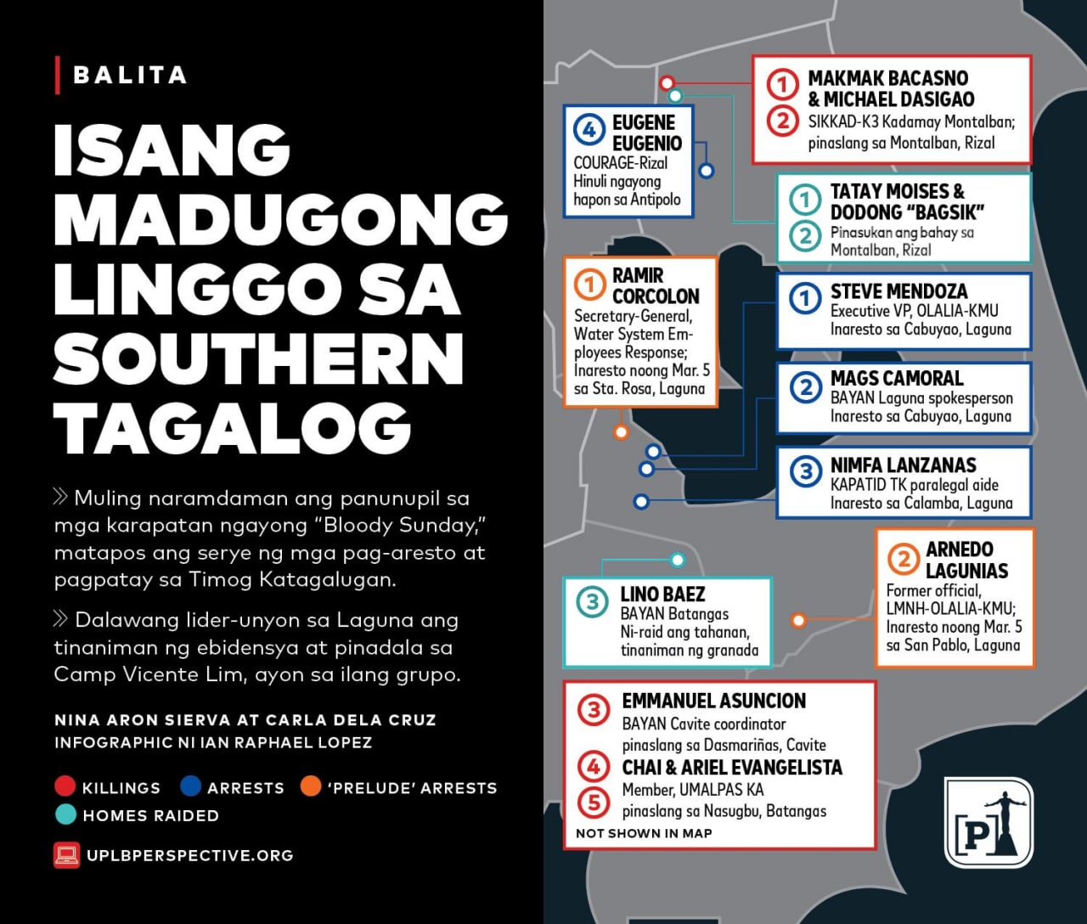
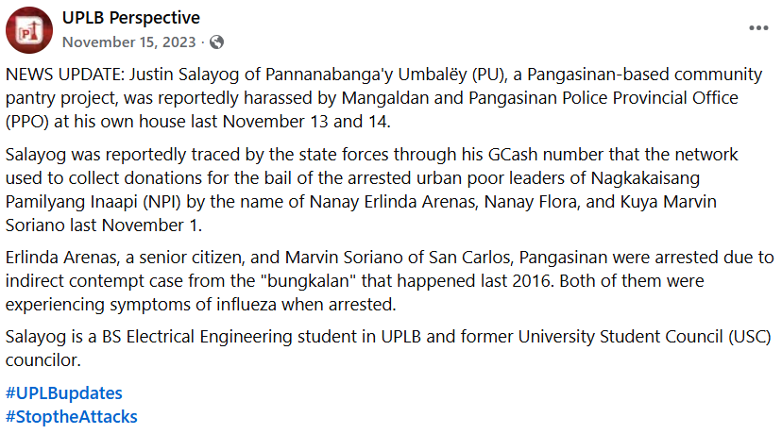
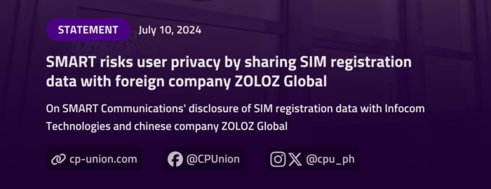
The vulnerabilities in our legislation show no sign of stopping here, as a new bill was filed to require social media accounts to be registered.
UP INTERNET FREEDOM NETWORK | DRAPAC 2025

Slide 4
What can we do in the state of privacy?
Integrate privacy and security into your daily activities. UP Internet encourages this through its cybersecurity workshops for the people.
UP INTERNET FREEDOM NETWORK | DRAPAC 2025

Slide 5
Take part in the campaign for privacy!
Connect with us through upinternet.org@protonmail.com.
UP INTERNET FREEDOM NETWORK | DRAPAC 2025

