Slide 1

Tech-Facilitated Abuse: A Threat to Democracy & Human Security
Findings from Malaysia
Suyin Chia, Researcher
Hari Shanker, Data Analyst

Slide 2
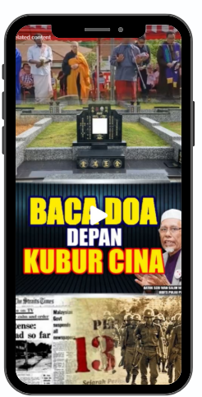
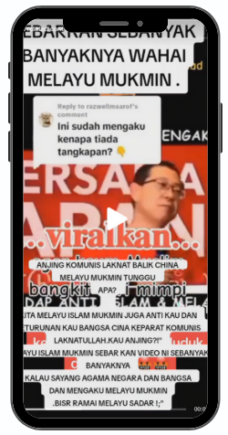
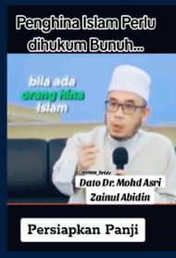

Social media increasingly key political battleground
Increased online hate speech and divisive racial and religious rhetoric since 2015 General Elections
Amplified by certain political parties, NGOs, influencers, religious leaders, pseudo-news channels, cybertroopers, and bot accounts
Inflammatory content and user activities peak during “election season” mirroring issues and incidents related to race and religion

Slide 3
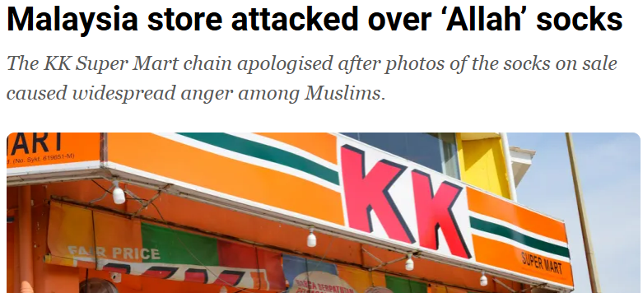

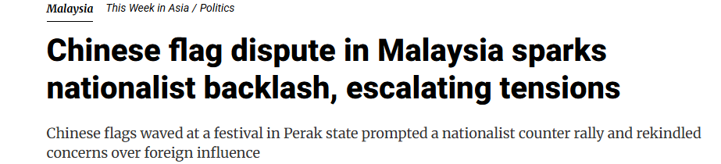
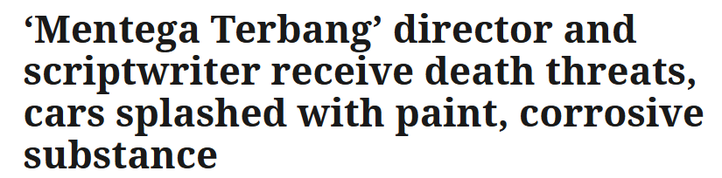
Cumulative online harms risk escalating political conflict
Engagement-based profit model & recommendation algorithm incentivizes the very content tech companies claim to regulate
AI tools amplify conspiracies and disinformation and make toxic content appear like grassroot sentiments
Coordinated online campaigns: doxxing, cyberattacks, targeted propaganda against minority groups, human rights defenders and public servants
Online radicalisation already leading to rising offline vigilantism and violence against individuals, institutions, and businesses
Gradual erosion of content moderation infrastructure reflects deeper shift in alignment with reactionary, authoritarian, and ethno-nationalist politics

Slide 4


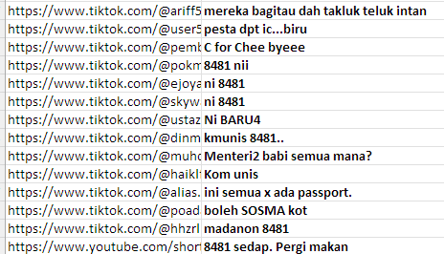
Examining online discourse and sentiments at scale
LLMs provide flexibility in analysis but lack sensitivity when classifying sentiment
Models cannot reliably interpret content with colloquial language, sarcasm, emoji, dog-whistling, and coded-language
Context makes all the difference for models
Prompts to dynamically adjust analysis criteria | Multilingual texts & under- represented languages
Various NLPs handled by one LLM | Sentiment labeling lacks sensitivity
LLMs can be fed various data to enhance context
Supervised learning models have better sensitivity but have limited ability to receive context
Multimodal models that receive both text and visuals may perform better

