Slide 1

Knowledge Hub
21 March 2025

Slide 2
Anti-rights sentiments in Malaysia: A study on anti-gender narratives
Umyra Ahmad
Notes:
Overview:
Focus on anti-rights narratives, specifically GI and its impact on OGBV and censorship of LGBT community
My focus is on narratives that seems very general but when we talk about narratives we are talking about stories and beliefs that reinforce dominant ideologies, prejudice and bias that translated into abuse and harm.. it's interlinked with religion eetc
What im sharing isnt new, SIS, JFS, CIJ do most of this work in terms of media monitoring, legal challenges- anti-gender offers a framnig that helps us focus on harms coming from a specific ideologies,

Slide 3
Anti-rights & anti-gender
“Gender ideology” a narrative used by conservative actor to target marginalized communities, especially LGBT persons, LGBT and women human rights defenders.
Origin from religious conservative actors in the international human rights system, such as the Vatican
Aim of ‘gender ideology’ narratives: to reinforce gender stereotypes and roles, and cis heteronormative hierarchy. Roots in patriarchy and used to delegitimize activists and evidence based advocacy demands, and stoke fear
Source: Observatory on the Universality of Rights, Rights at Risk Report 2021
Notes:
Broad definition as a place holder to oppose; a kind of backlash against anything progressive- opposition to the protection of rights related to gender, gender identity and expression, framed as resisting the imposition of so-called “gender-ideology,” or “LGBT ideology” or even “Western ideology”
Underpinned by the rise of religious fundamentalisms and right wing populism that aim to undermine democracy and human rights as a whole.
Focus on Narrative & disinformation as a tactic
Usually judeo christian, but has many similarities to other fundamentalisms

Slide 4
Key Actors
Who are the key actors in Malaysia? Federal constitutions interpretation of gender + legal jurisprudence, State bodies: Minister and Deputy Ministers at the Prime Minister’s Department for Religious Affairs, MCMC, ministry of health, Members of parliament, Politicians + political parties , Organisations: religious conservative NGOs such as WAFIQ, Isma, academicians

Slide 5
Tactics & Strategies in Malaysia
Infusing global ‘anti-gender’ narratives with local and national religious and social context:
  Promotion of the “natural state” and “ return to the right path,” to reinforce around gender roles and gender binaries
  Imposition of “Western values” vs Asian values & Islamic values
  “Protection of the family”: demographic control for political gains
Disinformation targeting LGBT persons
  By politicians, state religious departments. Spread through mainstream media, social media, entertainment
  Narratives include: Pathologization and demonization of LGBT persons (LGBT persons as mentally ill, cause of HIV, MPOX), LGBT persons can be corrected or return to the ‘right path’
Policing morality and expression to ensure strict adherence to strict gender norms
Notes:
Narratives:
Fear based- a threat
we are familiar with, natural role of women and men, natural biology given by god- important to understand anti-gender equality on same spectrum with anti- LGBT
They are the arbrtrier of values: what is western or not- what is islamic or not- patriarchal interpretation of quran, etc. link to democracy- SIS can talk about this more- who gets to decide what is islamic or not- a group of m
Protection of the family- from my research and conversation with activists- we see conservatives focus on sanctity of family institution. Konvesyen wanita, 2022: pushing for muslim malay women to bear children as much as possible- different from mainstream islamists. What is different, kalau tak dapat anak, kena usahakan juga. Another session, about choosing political leader- kita kena undi malay leader. Two issues seem different but are not- tengah aim banyakkan malay votes. Not just lgbt, about votes
Disinformation: Justice for sisters does media monitoring, and what they find is a similar trend of targeting LGBT people worldwide- main components include, LGBT as sinners, sick.. Right path is a narrative guise under compassion but actually same in telling lgbt people to change themselves- also basis for conversion therapy- government regious dept invest money in a lot of this
Policing In the public sphere, enforcement gender segregation and policing of dress codes have become more strict, defeating the claim by Islamists that measures upholding Islamic doctrines only affects Muslims.
Divergences & similarities between global & Malaysian anti-gender movements: Conservative actors around the world learn from each other globally
Generally been identified with ultra-conservative religious in the west, Africa and fundamentalist actors
Adapting talking points from anti-gender movements globally:
Fear based, fuels moral panic & paranoia: ‘threat to religion and culture,’ “western ideas”
‘Protectionism’: protect “Family values.” Protect children. Protect religion
Uses disinformation, data manipulation, and sensationalism
Claims monopoly definition of culture, religion, ‘nature’ and ‘natural order’
Use of social media & disinformation

Slide 6
Tactics & Strategies in Malaysia
Advocacy of conservative NGOs that misuse and co-opt of human rights framework, language and processes
  Proliferation of conservative NGOs whose main aim is to counter progressive movements and ‘liberalism’
  Uses a mix of discursive regressive Quranic interpretation and misuse human rights framework to reinforce gender roles and gender binaries:
    “Freedom of religion and belief’ used to justify conversion practices
    ‘Women’s rights’ to reinforce role of women in the family and “home maker”
  Submits reports to the United Nations such as UPR & CEDAW
  Gaps on exact funding information (maybe others could share as well)
Notes:
GI another instrument, but cara sama dari islamist- staretgy utama dalam dia nak counter group tak setuju dengan perojative labelling. Labelling of LIBERAL as a dirty word
They realise they can use human rights language for legitimacy but actually manipulation
Lgbt people’s right to go back to the right path, but actually violates their rights- at the same time stops lgbt people from practicing their religion through moral policing- at state level Perlis mufti announced that trans women are banned from entering mosques in Perlis. The Deputy Minister at the Prime Minister’s Department, added that the government is also exploring a similar ban in Kuala Lumpur.
On the surface they agree with womens rights demands like to combat sexual harameenet and GBV, but if you scratch the surface, they believe women should play only certain roles

Slide 7
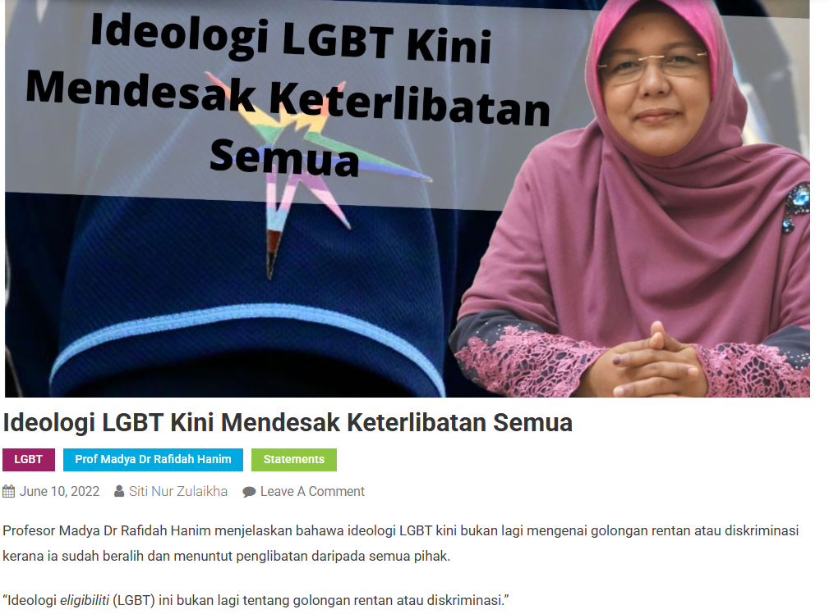
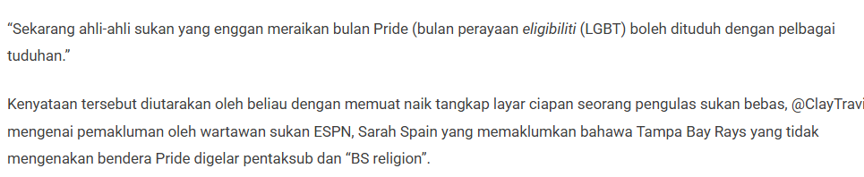

Slide 8
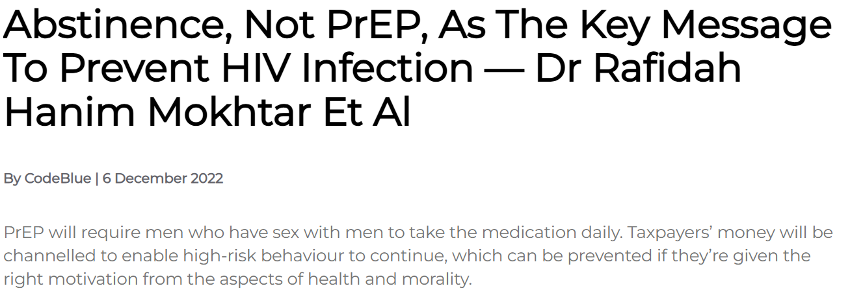
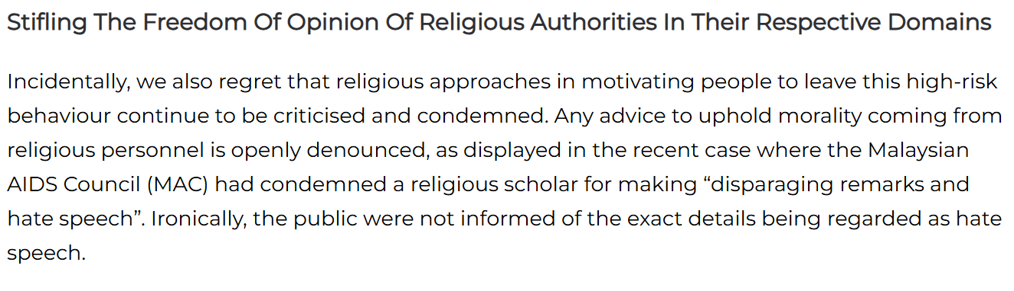

Slide 9
Impacts
Increased in online gender based violence against persons with diverse SOGIESC
Hate speech & death threats: In 2022, Centre for Independent Journalism & Justice for Sisters Election hate speech monitoring found offensive speech related to gender and sexual orientation was 3 times higher than religion- and race-related offensive speech.
Doxxing, with no accountability of perpetrators
  In 2022, the identity, personal details and employment history of a transmasculine person who was performing umrah in male prayer garb or ihram in Mekah was exposed by Harian Metro
  Federal Territory Mufti’s Office released details of the birth certificate of Nur Sajat, to the mainstream media, which they had allegedly obtained from the National Registration Department.
Reference: ICJ, Silenced but not Silent
Notes:
Look at 2 aspects of online abuse using ‘gender ideology narrative’ mentioned ealier:
Leads to increase in GBV online by state actors, individual actors, mob mentality
Sanctions and punishment by the state online- through censorship, etc
activists interviewed by the ICJ noted that LGBT individuals often choose not to pursue cases due to fear of reprisal, including in cases of doxing of transgender individuals.2
SOGIE-based online violence, abuse and hate speech are similarly commonplace against LGBT people in Malaysia, where they have been compounded by anti-LGBT sentiments,by State actors and society, and also laws. These sentiments usually carry religious and sexual overtones, and are expressed through the use of pejorative terms, and resort to body shaming of transgender and gender diverse individuals, and sexualization of LGBT individuals.

Slide 10
Impacts
Increased censorship & restriction of freedom of expression and association
  Website blocking using the Communication and Multimedia Act 1998 (CMA), section sections 211 and 233
    Sinar Project’s iMAP documented the blocking of at least six websites featuring LGBT-related content within a six-month testing period from 1 January 2022 to 30 June 2022, ranging from news sites featuring LGBT-related content, dating sites and websites of LGBT non-governmental organizations
  Legal sanctions against LGBT expression online, under the CMA, section 233
    Includes posts that defend LGBTQ rights or challenge conservative interpretations of gender and sexuality. Online spaces are heavily monitored
    Local artists have been charged for sharing on social media platforms their music videos featuring gender-diverse performers.
      Aliff Syukri, an entrepreneur was summoned by the MCMC as a result of an investigation into a music video
      Datin Vida was facing criminal charges for uploading a music video in April 2022 allegedly featuring LGBT dancers
Reference: ICJ, Silenced but not Silent & Justice for Sisters
Notes:
Laws are often use as a basis to punish lgbt expression online- so laws + popular narrative used to punish
Culture wars have material impact and harm
Online and offline continuum- parallel with censorship of freedom of expression in real life, we see increase policing of attire, expression etc
for example CMA Act 1998 used
- section 233 that criminalises the use of network facilities or services to create, publish, or distribute content deemed “obscene,” “indecent,” “false,” or that causes “annoyance, abuse, or threats. vague language enables authorities to weaponise the law against dissenting voices, particularly those challenging the government’s discriminatory policies or promoting equality.
https://www.queerlapis.com/survey-findings-impact-of-covid-19-anti-lgbt-narratives-on-lgbtq-persons-in-malaysia-out-now/
er: Film censorship guidelines prohibit positive depictions of LGBT people
Printing Presses and Publications Act is increasingly used to ban LGBT-related books for being ’detrimental to public order, morals and public interest.

Slide 11
How to respond?
More coordinated effort among civil society to combat disinformation
  More effort to link narratives to material harm based on data and evidence on sexual minorities
More resources and information to clarify concept of gender and gender equality
More resources to deconstruct and address gender stereotypes, gender binaries and concept of the family
Strengthen collection of data on gender ideology for policy making and to address barriers on LGBT persons access to healthcare services, employment and legal gender recognition
Notes:
Linking narrat

