Slide 1


Online Child Sexual Exploitation and Abuse (OCSEA)
Knowledge Hub
By: Fir Redzuan, Founder
Notes:
Thank you INITIATE.MY for coordinating the Knowledge Hub for the benefit of all parties involved. I am Fir, representing Monsters Among Us or MAU. We are a youth-led organisation founded in 2017 that focuses on the promotion of child rights through a gender based and child participatory lens. Our staple projects include My Body My Rules, a comprehensive sexuality education programme for teenagers and Lapor Predator, an initiative to prevent and address online child sexual exploitation and abuse.
My role here today is to shed some light on what is considered a hidden public health emergency by many experts and organisations around the world, online child sexual exploitation and abuse or OCSEA.

Slide 2
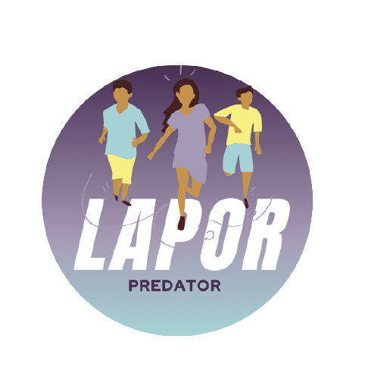
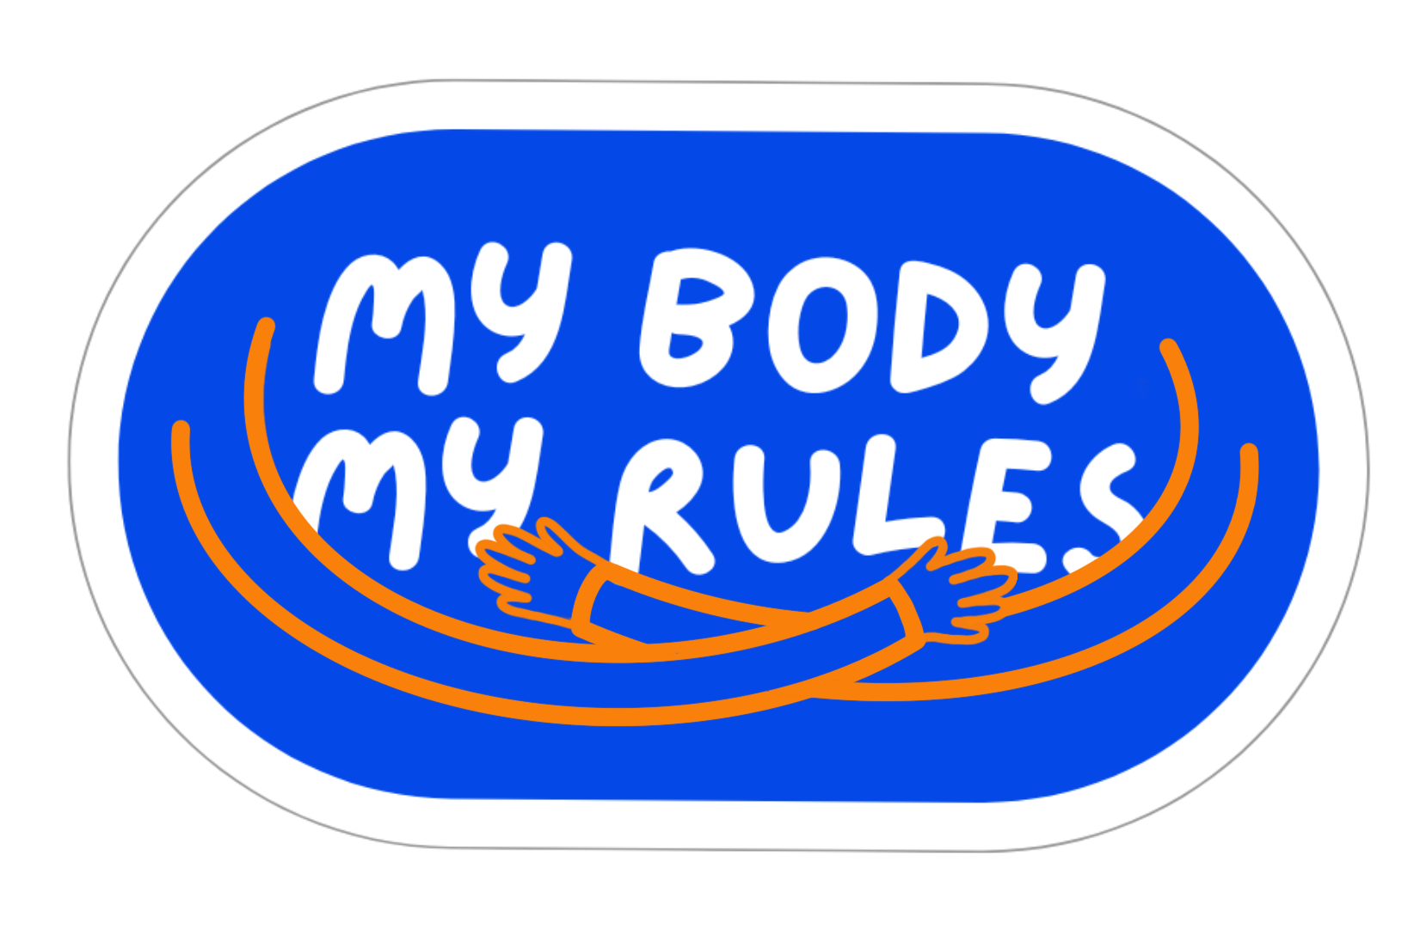
Youth-led
Promotion of child rights
Gender equality and child participation approaches
Capacity strengthening, advocacy, community building
Notes:
Thank you INITIATE.MY for coordinating the Knowledge Hub for the benefit of all parties involved. I am Fir, representing Monsters Among Us or MAU. We are a youth-led organisation founded in 2017 that focuses on the promotion of child rights through a gender based and child participatory lens. Our staple projects include My Body My Rules, a comprehensive sexuality education programme for teenagers and Lapor Predator, an initiative to prevent and address online child sexual exploitation and abuse.
My role here today is to shed some light on what is considered a hidden public health emergency by many experts and organisations around the world, online child sexual exploitation and abuse or OCSEA.

Slide 3

Why does this matter?
Tech abuse: who is ACTUALLY responsible?
UNCRC and other guiding frameworks Malaysia is party to
Best interest of the child
Notes:
POINT 1
Risk of tech abuse is still going to be present, with or without the general elections. However we see GE as an opportunity to advocate for meaningful change, spearheaded by decision makers of the country alongside tech industries for the best interest of the child
The recently passed Online Safety Bill was evidence that there was limited expertise and capacity to have a united front. The clash between right to privacy, data protection, freedom of expression and child rights arose as though prioritising the best interest of the child will diminish the other rights.
While CSOs went back and forth with our discussions, the government and tech industries were left off the hook as the Bill was passed in its immature state. Hence the second question, who is the actual actor perpetuating and enabling harm?
POINT 2
This Knowledge Hub comes as a perfect opportunity for us to sharpen our knowledge and advocacy strategies to safeguard Malaysia’s freedom to expression and the best interest of our children. It squarely fits into Malaysia’s commitment to the Convention of the Rights of the Child which stipulates industries and civil societies having to step up for the most vulnerable, especially children
POINT 3
All of us play a role in building a safer and healthy digital space. Like it or not, our decisions impact our rights. So this is opportune for us to make sure that those decisions are in the best interest of the child where children can develop to the maximum extent possible - UNCRC

Slide 4
Definition of CSA
Sexual abuse takes place when
a person in power
coerces, tricks, and/or forces
a child to take part in a sexual activity, using the child for their own sexual gratification.
Source: Protect & Save the Children Project Reach
Notes:
Today’s focus is on Online Child Sexual Exploitation and Abuse,.
Child Sexual Abuse of CSA is defined as…
Children are those below 18 years of age
The keywords here are children who are aged 17 and below, according to our law and person in power; a person in a position of power could be anyone of us who have advantages based on our age, experience, capital either financially or socially. An offender could be a parent (which comes as the number one perpetrator according to RMP), a person in a relationship of trust i.e. teachers, doctors, employers and others.

Slide 5
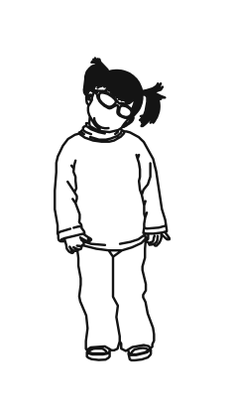
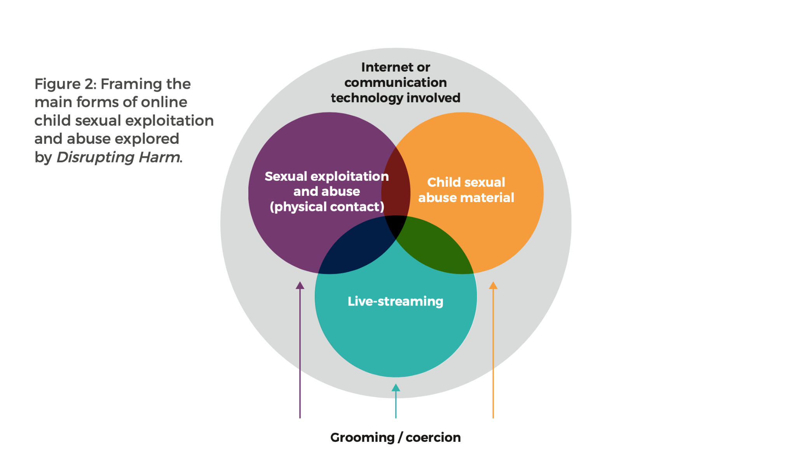
OCSEA Trends
CSAM Distribution
Peer-to-peer networks
Twitter
Web searches
CSAM Hosting
Links to Travel and Tourism
Online grooming
Self-generated Sexual Content involving Young People
Harmful sexual content sent to a child
Source: PDRM, Disrupting Harm Study in Malaysia
Notes:
This is a visual to show how technology facilitates abuse within digital spaces and in physical spaces too
And it is clear that abuse and exploitation may happen either completely online or via a combination of online and in-person contact

Slide 6
OCSEA Trends
CSAM Distribution
Peer-to-peer networks
Twitter
Web searches
CSAM Hosting
Links to Travel and Tourism
Online grooming
Self-generated Sexual Content involving Young People*
Deepfakes that manipulate imagery using machine learning/AI
Harmful sexual content sent to a child
Source: Disrupting Harm Study in Malaysia, bodyright campaign, Internet Watch Foundation
Notes:
Here are some growing concerns surrounding children’s vulnerability to OCSEA.
But focusing on two trends, online grooming and AI-facilitated abuse
Grooming relies on exploiting children’s insecurities and trust—often to get them to take “nudes”. When they oblige, kids don’t realize that they’re actually creating self-generated child sexual abuse material (SG-CSAM). That material can be used by groomers to threaten kids into a form of blackmail called sextortion.
According to IWF platform, over 20,000 AI-generated images on a dark web forum in one month where more than 3,000 depicted criminal child sexual abuse activities in 2023. “These incredibly realistic deepfake, or partially synthetic, videos of child rape and torture are made by offenders using AI tools that add the face or likeness of a real person or victim.”
Of the AI-generated images confirmed to be child sexual abuse on the forum, more images depicted the most severe Category A abuse, indicating that perpetrators are more able to generate complex ‘hardcore’ scenarios. IWF June 2024
AI Child Sexual Abuse Featuring Known Victims and Famous Children: Perpetrators increasingly use fine-tuned AI models to generate new imagery of known victims of child sexual abuse or famous children. IWF June 2024

Slide 7
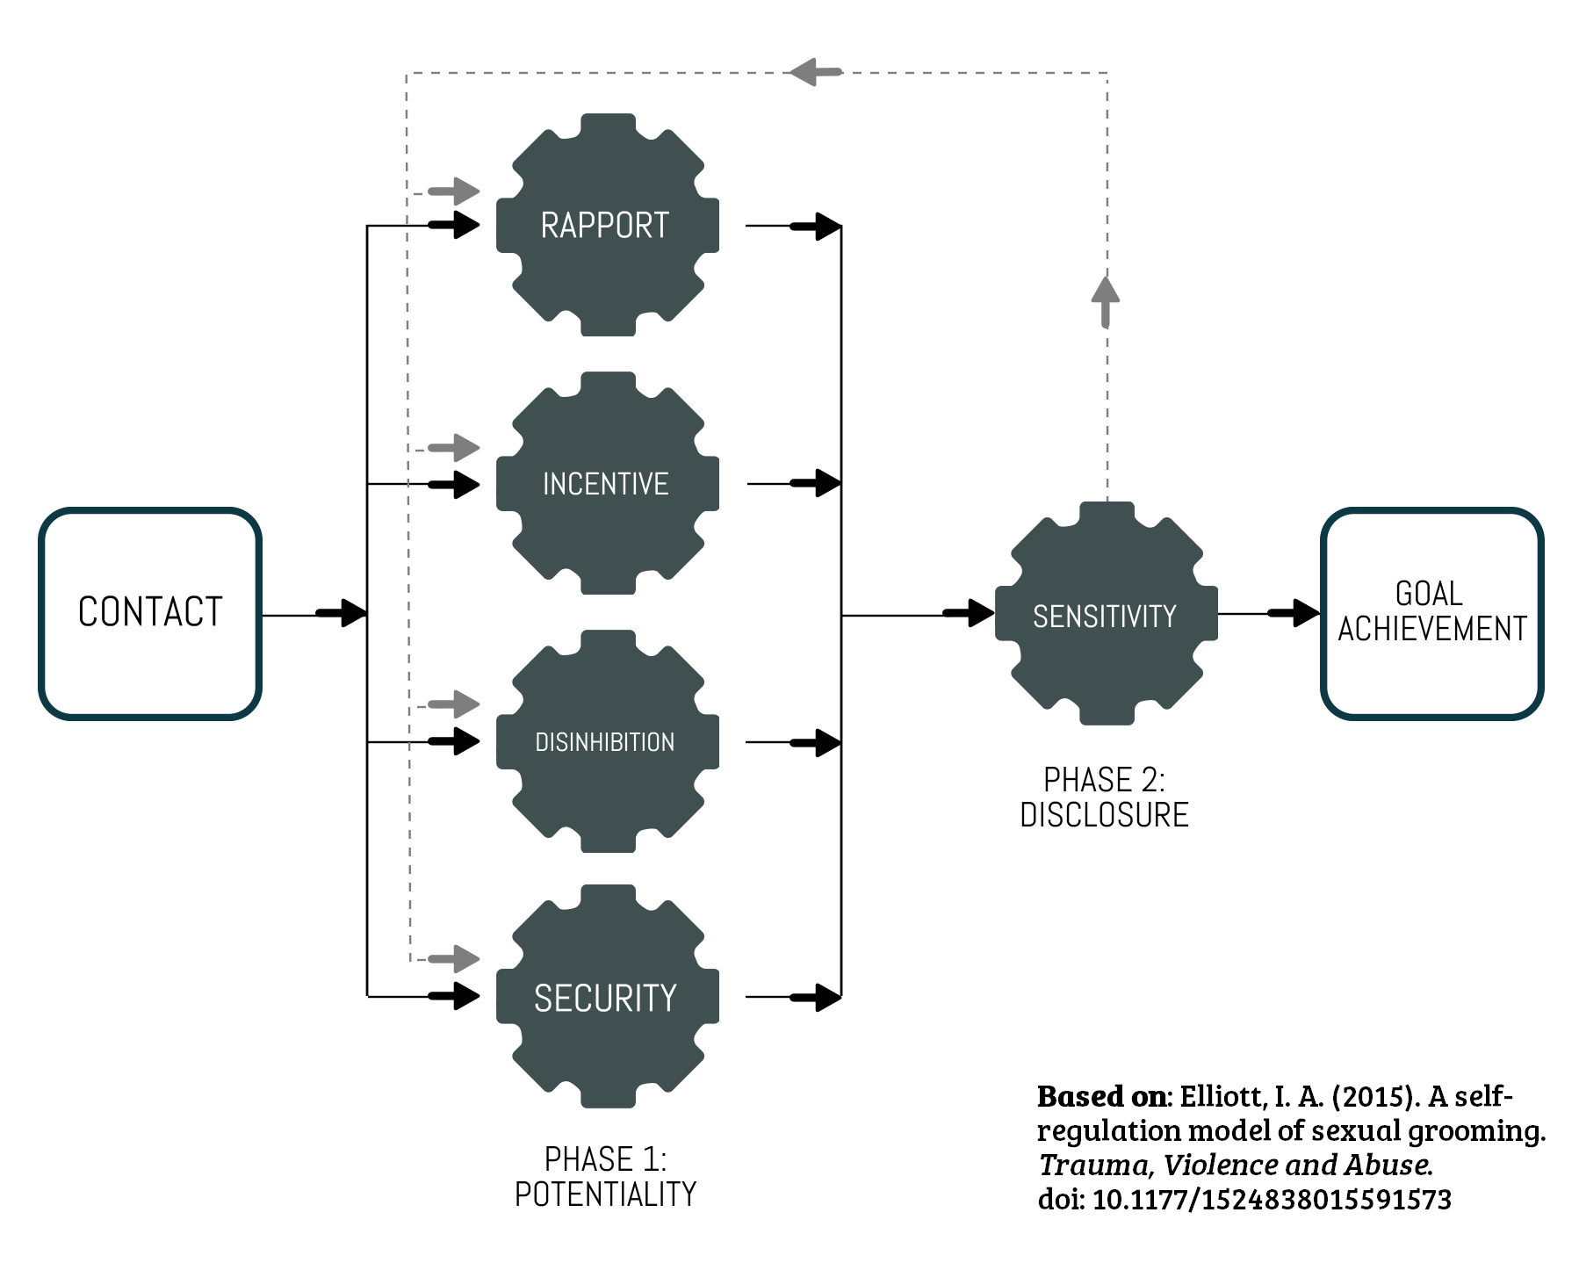
Notes:
This diagram shows the grooming tactics or process that offenders use to prey on children
Grooming is a process of exploiting trust to shift expectations of what safe behavior is and leveraging fear and shame to keep a child silent. (https://www.thorn.org/blog/online-grooming-what-it-is-how-it-happens-and-how-to-defend-children/)

Slide 8

Actors
Internet users (Strangers, family members, friends etc)
Organised criminals
Tech companies and social media providers?
Enablers
Lawmakers and regulators
Tech companies and social media providers
Source: Disrupting Harm Study in Malaysia
Notes:
The current Malaysian government has a key role to set a strong standard for children’s safety through the Bill but how do we hold them accountable?
How do we make sure that the government holds tech industries accountable?
Is the Online Safety Act sufficient and effective to ensure a chain of responsibility including all relevant stakeholders?
Protecting children and young people is a shared responsibility and it is upon all relevant stakeholders to ensure a sustainable future for all. For that to happen, policy makers, the industry, parents, carers, educators and other stakeholders, must ensure that children and young people can fulfil their potential – online and offline. ITU Guidelines for policy-makers on Child Online Protection 2020
This is something this space can help answer

Slide 9
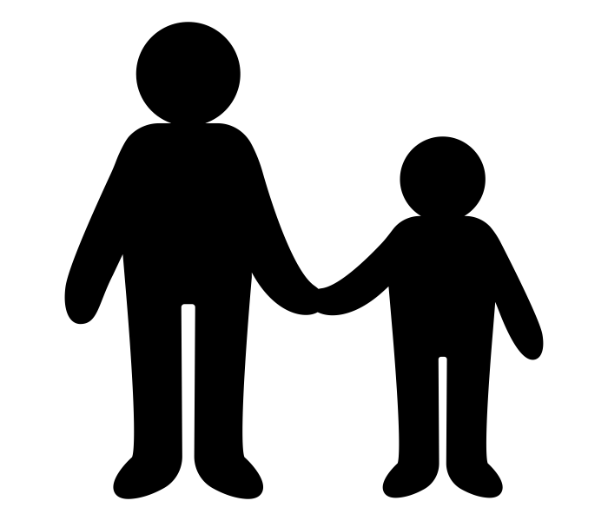
Tactics
[Gaps (?)]
Protection = Control vs User Autonomy
Children and adults are not differentiated in the application of law
Tech companies are ‘off the hook’
Youths Paving the Way to Safer Childhoods
Source: Leaked, Childlight
Notes:
POINT 1
The laws and policies currently do not account from children’s digital rights. Therefore their solutions strip away rights rather than realising them
For example, Fahmi’s solution is to ban social media access to 13 year olds and below (https://www.google.com/url?sa=t&source=web&rct=j&opi=89978449&url=https://www.malaymail.com/news/malaysia/2024/08/10/no-social-media-for-you-kids-fahmi-says-new-rules-will-protect-minors-curb-paedophilia-online/146583&ved=2ahUKEwip2r-h95mMAxUbRmwGHS_PNDkQFnoECCgQAQ&usg=AOvVaw0BK113fXariTQIMxp6a4Xu)
POINT 2
The current law also does not account for children’s cognitive and sexual development. Self generated sexual content could be criminalised and impose harsh punishment including onto children. This include CMA too.
A very interesting research in Thailand called Leaked aims to understand and address self generated sexual content amongst young people there. It is found that “Sharing nude or intimate images with partners or peers has become increasingly common, and some young people say these behaviors offer spaces for sexual expression and relationship exploration. During the COVID-19 lockdowns, these behaviors were arguably the only avenue for young people to progress through natural sexual development.”
POINT 3
And as mentioned at the beginning of my presentation, tech industries are off the hook when conflicts and cyclical debate are unresolved. At the same time, children continue to be at risk or even harmed as we speak. In such cases, the ‘best interests’ of the child should be paramount. (5Rights, Online Safety Toolkit)
IMPACT
Self censorship esp for women, girls and queer folks
Criminalised and penalised
Compounded abuse
Ineffective and oppresive laws such as OSA

Slide 10

Way Forward
(Business and Child Rights)
Safety by Design
User autonomy and empowerment
‘Best Interest’ of the child [By Design, R&D etc]
Source: E-Safety Commissioner of Australia, 5Rights Online Safety Toolkit, OECD
Notes:
POINT 1 & 2
We may not solutions at this point but we stand by children and young people’s demands for a digital space that works for them. They want platforms that:-
Empower users by providing them greater control of their safety and experiences in the digital environment;
Provide clear guidance and rules that are easy to comprehend;
Provide users with safety features and tools;
Impose sanctions and consequences in case there is a violation of the rules of the site; and
Use filtering technology and scanning to ensure user safety is upheld on the site and that users are not exposed to sensitive or inappropriate content.
POINT 3
One of the policy action areas is R&D - which does include
Enable access to private companies’ data in the public interest

Slide 11
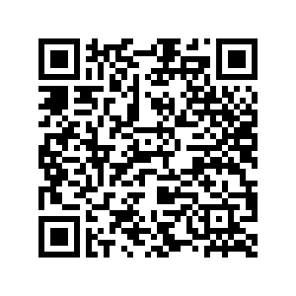
Resource Folder

Slide 12




Keep in touch!
laporpredator.org
https://www.facebook.com/
MonstersAmongUsMY
@mau17_my #MAU17
monstersamongus_my

