Slide 1

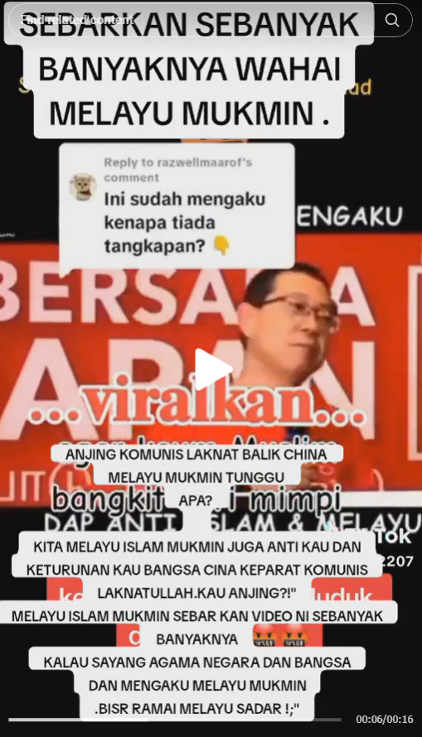
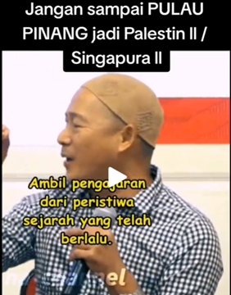
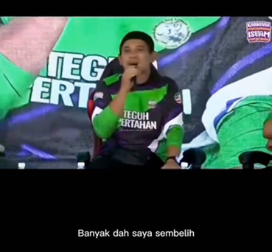
KEY FINDINGS
Far right influencers and key opinion leaders, like preacher Ridhuan Tee, peddle exclusionary and extremist narratives beyond their milieu
The employment of hate and violent language is normalised, such as actor Zul Huzaimy using term “Kafir Harbi” at a PAS ceramah stating he would have “butchered many”
Disinformation, such a about the 13 May 1969 memorial service, travels farther, faster, deeper and more broadly than the truth
Abuse of AI facilitates the scale and creativity of hate content
Notes:
Far-right preacher Ridhuan Tee compares Penang to Israel’s “creeping colonialism” in Palestine

Slide 2


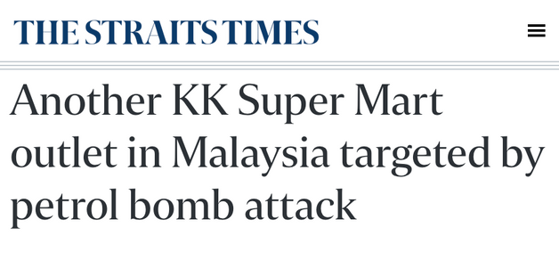
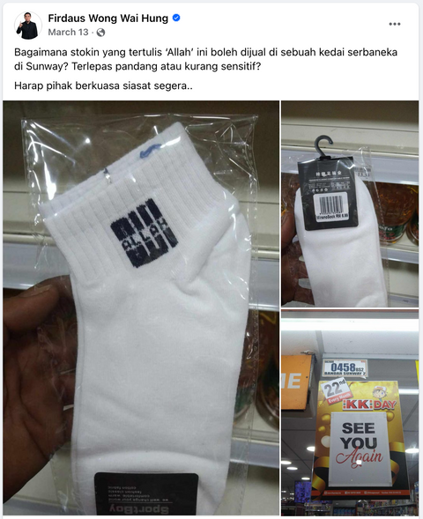
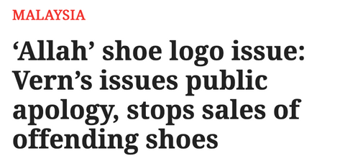
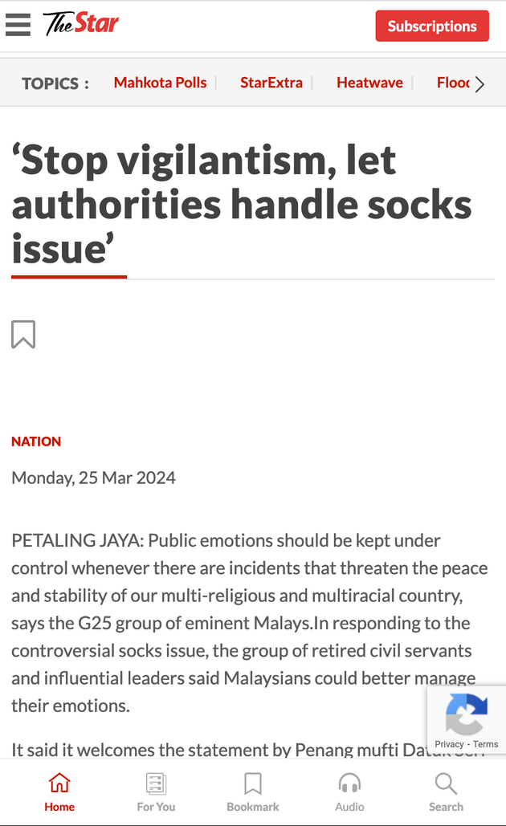
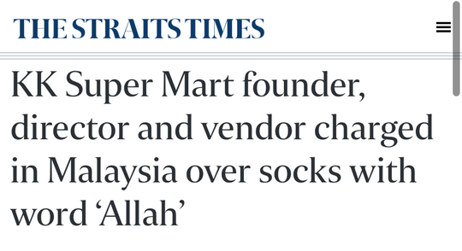
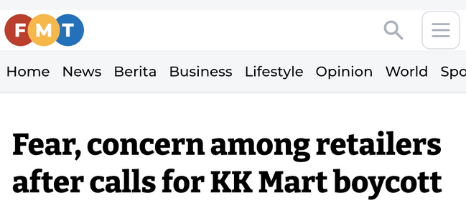
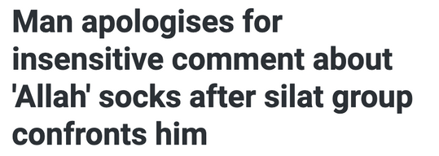
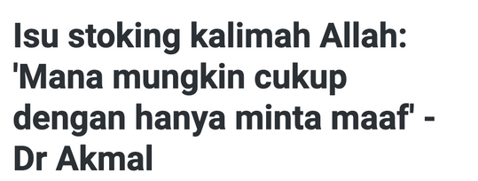
KEY FINDINGS
How it started
How it manifested
How hate is manufactured, mutates and has real-world consquences
Notes:
Generative AI tools utilised to generate fake images, videos, and misinformation campaigns to exploit societal divisions and vulnerabilities.
Adds complexity to efforts to monitor and counter disinformation and propaganda, challenges the enforcement of community standards & legal frameworks.
For example: Far right group also exploit global political events such as the ongoing Israel-Palestine conflict to influence domestic politics & incite anti-minority sentiments.
While sympathy to pro-Palestinian cause is commendable, the probable risk of extremist expressions
dehumanisation of others can and has led to real-world harassment from vigilante individuals: McD workers
a reimagining of self as militant or in the frontline, particularly women; comments sections
Rise of a religious army to defend both the homeland and Palestine

Slide 3



THREAT ASSESSMENT
Normalisation of dangerous hate.
The normalisation in online spaces leads to its tolerance and lack of challenge by society and, to a certain extent, by authorities. This environment enables the spread of extremist rhetoric from hardcore in-group supporters to a sympathetic public and potential converts, particularly young people.
Deepening social fragmentation.
Far-right movements actively stresses structural drivers of social fragmentation, such as amplifying polarisation along religious and racial lines, for personal, political, and financial gains. These networks will again be very active, and more “battle-ready”, leading up to the next General Election.
Escalation of violence.
Individuals exposed to hate and violence, particularly those sympathetic with far-right ideologies, are at heightened risk of self-radicalisation on social media platforms with aggressive engagement-based algorithms. This online radicalisation have led to rising offline vigilantism and violence, including cases involving Siti Kassim, Nik Elin, Mentega Terbang crew, PM Anwar Ibrahim, anti-Rohingya campaigns, and KK Mart.
Undermining democratic institutions and values.
Unfettered conspiracy theories and disinformation fuel skepticism toward democratic institutions, including legal and judicial systems, electoral processes, and their outcomes. The rise of vigilantism, and actions exerting political intimidation on those involved in democratic institutions, is a clear indicator of this growing distrust.

Slide 4
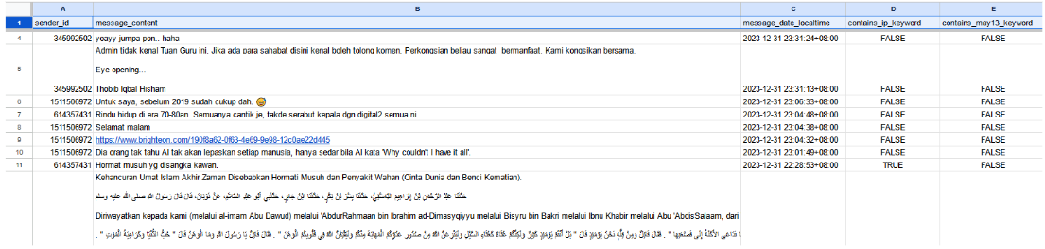
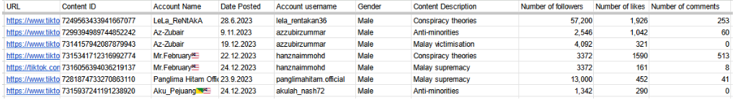
DATA COLLECTION & ANALYSIS
  Researchers identified dynamic keywords and accounts associated with extremist individuals, groups ideologies, and related incidents and events.
  Automated and manual searches to identify texts, videos, graphics, hashtags, comments, and accounts
  Automated scrapping methods depend on the platform:
    TikTok
      Official Research API (not available in Asia)
      Code-based web scraping (difficult to execute)
      3rd party web scraping service
    Telegram
      Official Telegram API
  Researchers manually examined, confirmed, and identified specific content to shortlist, timestamp, classify, and assess threat level
  Findings further informed by other data sources – public records, articles, expert consultations, and scholarly publications
  RESEARCH CONTINUATION - Sentiment polarity analysis on targeted case studies

Slide 5
EVIDENCE-BASED ADVOCACY
Advocacy Thrives on Evidence
    Leverages data to effectively advocate for meaningful change
    Data sheds light on the magnitude, scope, and specific nature of societal issues issues.
    Larger data sources can uncover critiacl patterns, trends, and connections that offer valuable context to inform strategic responses
    Data analysis provides insight on impacts of existing policies, pinpoint areas requiring intervention, and predict future trends
    Targeted policy recommendations grounded in empirical data rather than subjective opinions
Our Findings Suggest
    Large number of posts in colloquial Malay illustrate significant volume of harmful content are bypassing built-in filters and AI detection mechanisms
    Simply removing offensive content from social media sites has limitations; highlighting the need for more proactive content moderation and community intervention approaches
    Online spaces are deeply interconnected with local offline communities, indicating that strategies for online intervention must align and support grassroot community engagement
    As next General Election looms, no amount of regulation and moderation can fully shield from disinformation; requires vigilant and informed public/netizens
Notes:
1.Targeted policy recommendations for better regulation of online platforms, and to review government response with regards to existing laws and institutional capacity.
2. Hold digital platforms accountable in improving their content moderation technology and approach
3. Findings suggest that simply removing offensive content from social media sites has limitations.

