Slide 1

Knowledge Hub
21 March 2025

Slide 2
How State Tech Abuse Impacts Civil Society: Malaysian Case Studies
Aizat Shamsuddin
Int’ Relations (UniMelb), Shariah & Law (USIM)

Slide 3
Trends
Censorship
  Weaponising laws and authorities
  Surveillance
Political projects
  Repurposing government agency. i.e. IKSIM
  Contracting private PR firms. i.e. Cambridge Analytica
Goals
  Amplify pro-state propaganda (often pro-majority)
  Silence dissenting voices, weaken their movement and morale

Slide 4
Tactics
Private data theft
  Data mining
  Doxxing
Socially-engineered narratives
  Feeding user algo
Alt-media platforms
  Pseudo-journalism
  Cross-platform posting

Slide 5
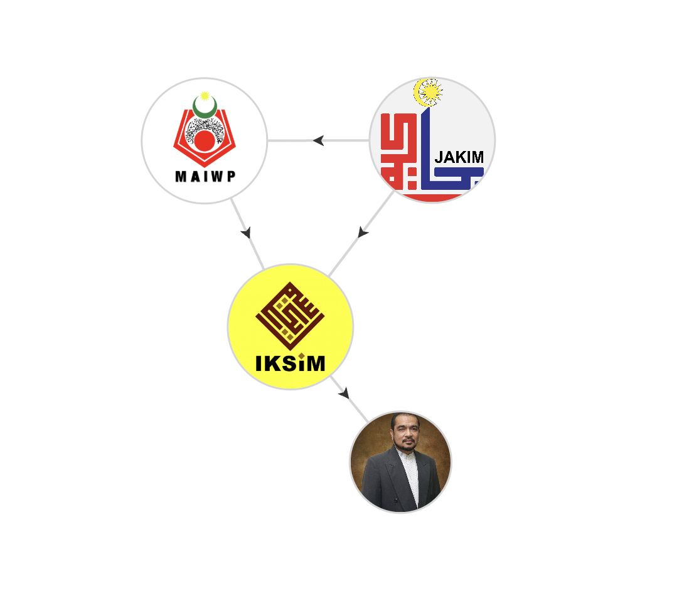

Slide 6
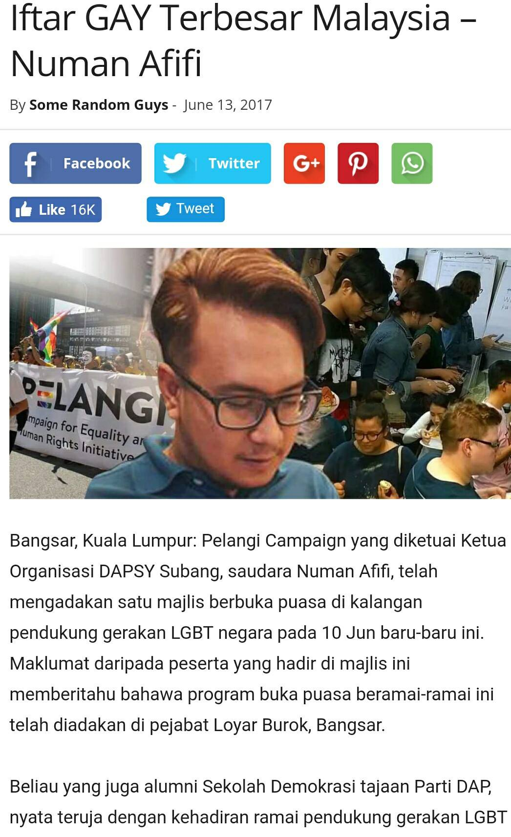
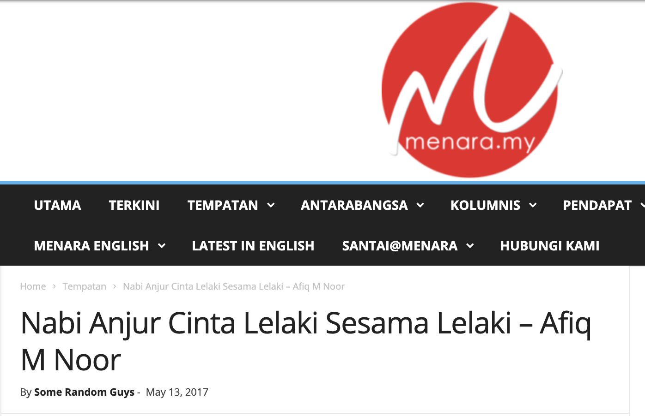
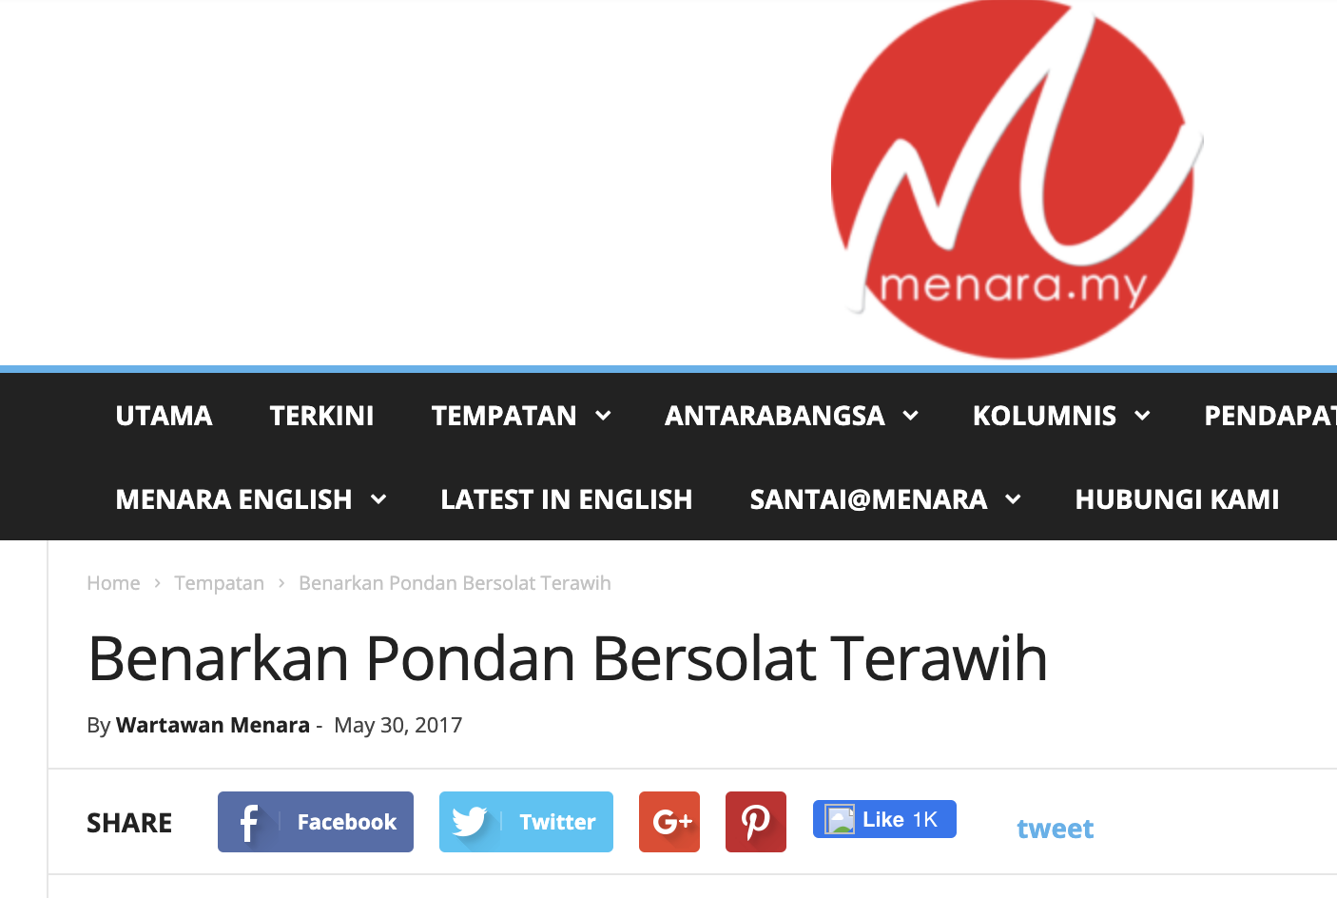

Slide 7
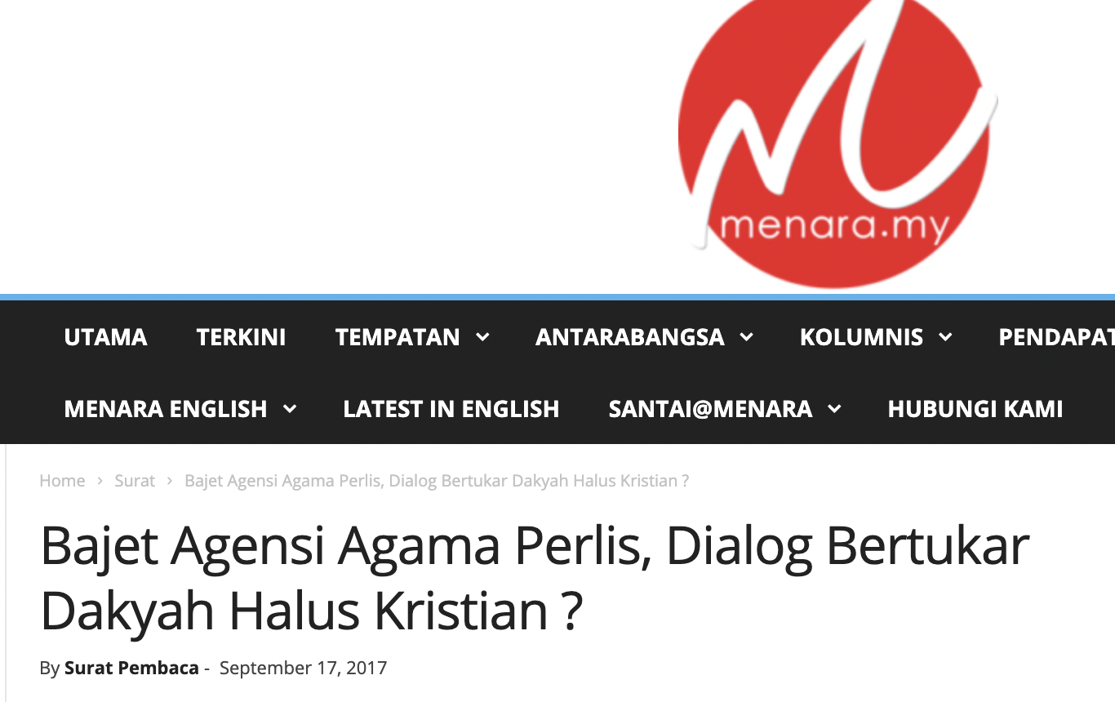
https://t.me/s/tolakwahabi?q=sivin+kit

Slide 8
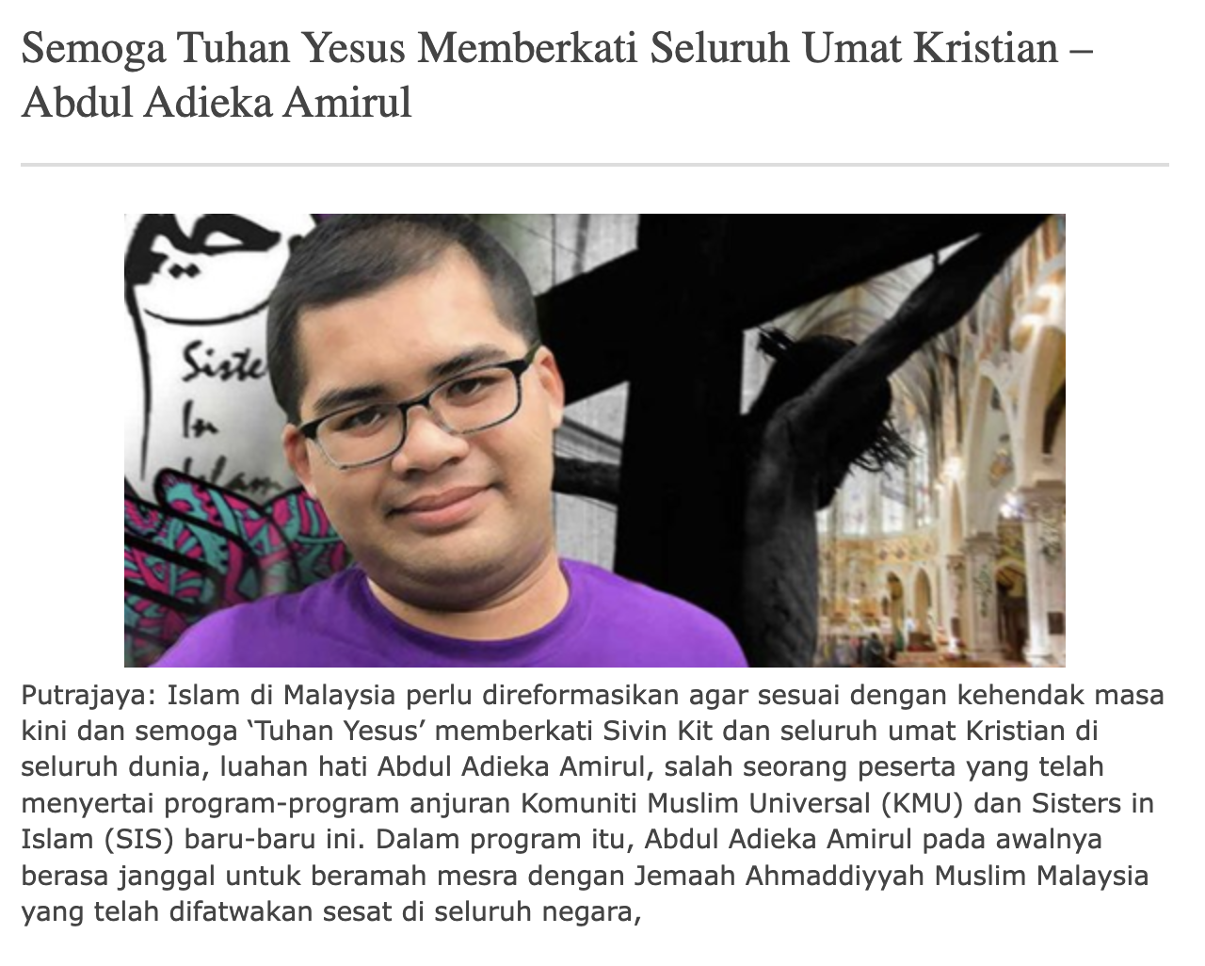
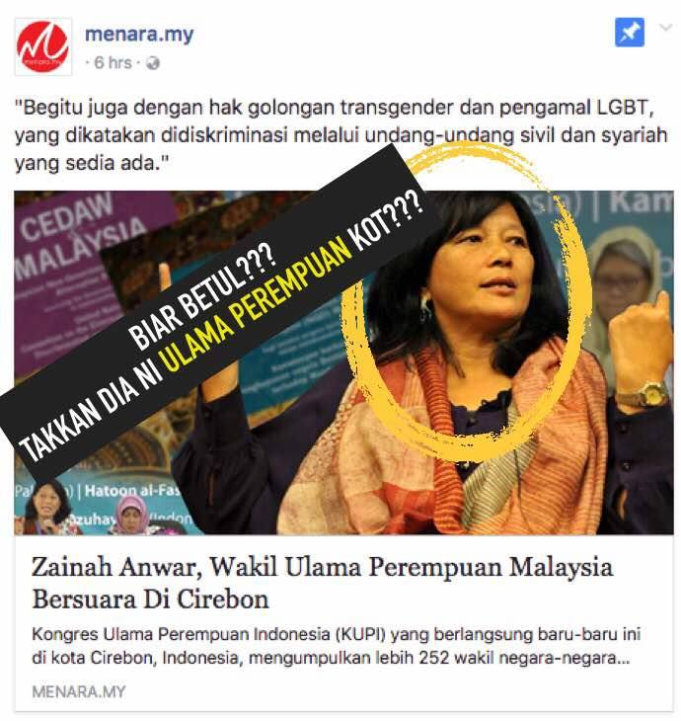

Slide 9
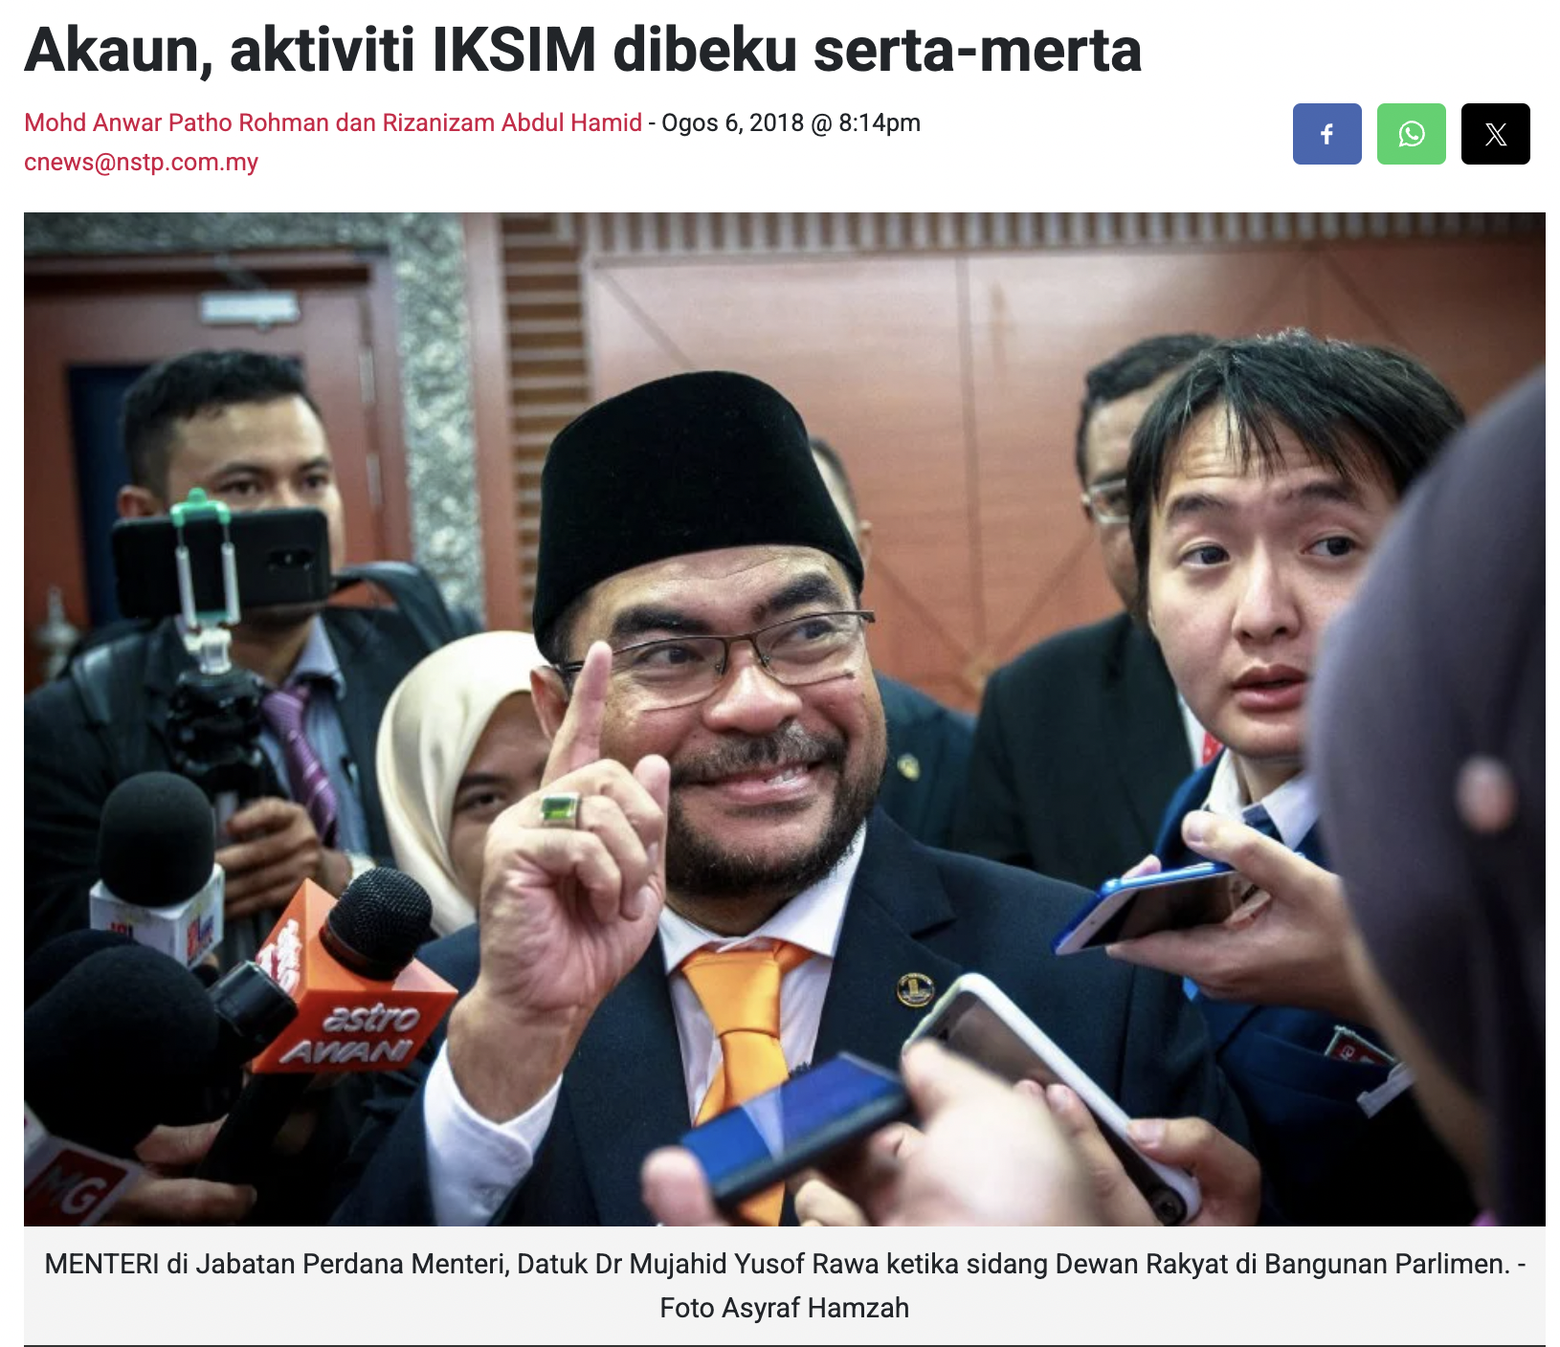
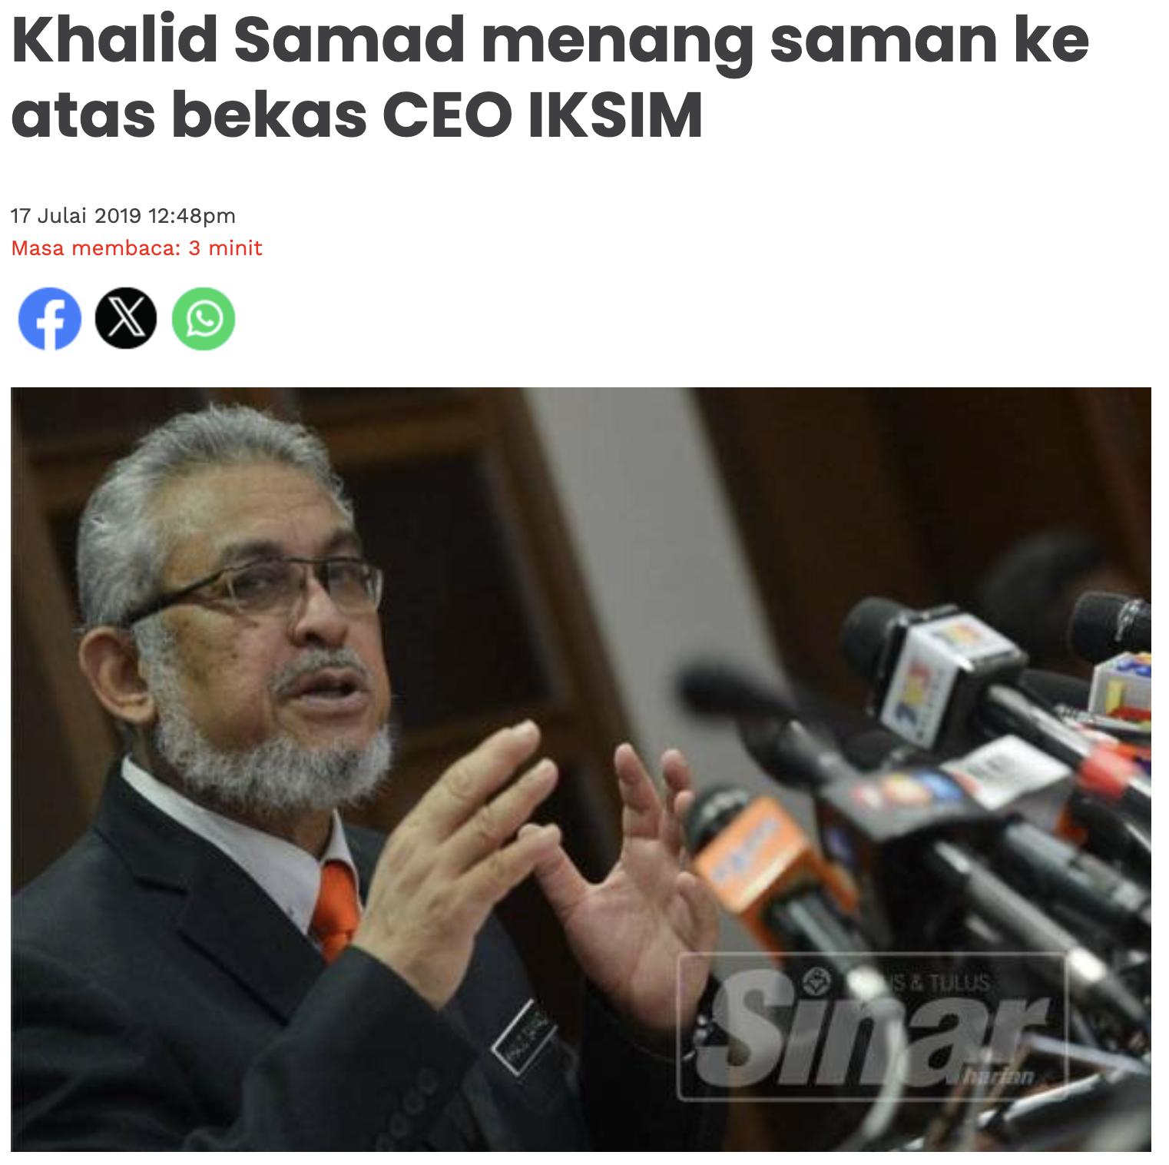

Slide 10
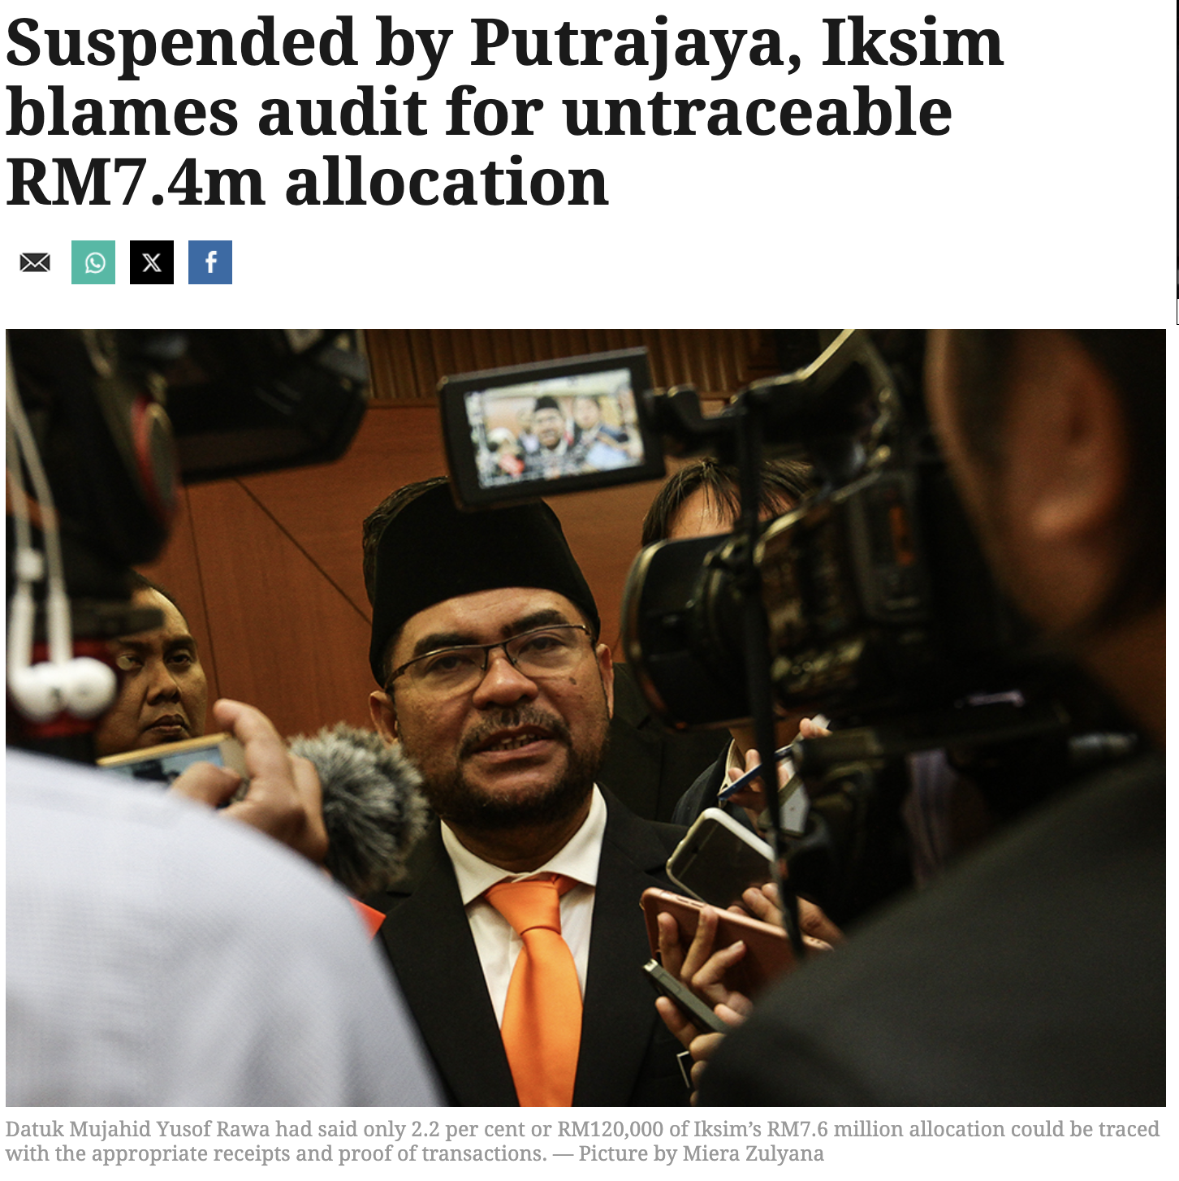

Slide 11
Risk Analysis
Extremism and authoritarianism pose a significant threat to civil society, democracy work
Spillover effect: online harms have real-world consequences
  Death threats and harassment
Monitoring and documenting these threats are crucial to supporting affected HRDs and communities through:
  Psychological and relocation assistance
  Counter-narrative initiatives
  Strategic litigation
  Exposure and advocacy

Slide 12
Risk Analysis
‘Offend’ than ‘defend’?
Responding to emerging and sophisticated tech abuse tactics: generative AI and deepfake tech.
How our legal frameworks protect HRDs and at-risk communities?
Notes:
“Defend” Approach (Reactive)
Focuses on protection and mitigation after harm has occurred.
Involves damage control through security measures, legal defenses, and awareness campaigns.
Example: Implementing stronger cybersecurity measures, fact-checking misinformation, and supporting affected individuals.
“Offend” Approach (Proactive/Strategic)
Focuses on taking the initiative to disrupt, expose, and counter tech abuse before it escalates.
Seeks to preemptively challenge bad actors, narratives, and exploitative systems.
Example: Using strategic litigation against digital disinformation networks, exposing coordinated attacks through investigative research, and holding enablers accountable, such as tech platforms or state actors.

Slide 13
Reference List
Penyata Rasmi Parlimen, Bil. 47, 14 November 2017 https://www.parlimen.gov.my/files/hindex/pdf/DR-14112017.pdf
Penyata Rasmi Parlimen, Bil. 9, 30 Julai 2018 https://www.parlimen.gov.my/files/hindex/pdf/DR-30072018.pdf
UPR Info. (2019, August). Joint Submission 12 on Malaysia for the 31st Session of the UPR. UPR Info. Retrieved from https://upr-info.org/sites/default/files/documents/2019-08/js12_upr31_mys_e_main.pdf
A clamour for Islamic reform in Malaysia: but in which direction under a Divine Bureaucracy? https://www.newmandala.org/a-clamour-for-islamic-reform-in-malaysia-but-in-which-direction-under-a-divine-bureaucracy/

Slide 14
Reference List
Malay Mail. (2018, November 9). IKSIM’s RM7.6m in funds frozen over alleged mismanagement, says Mujahid. Retrieved from https://www.malaymail.com
The Star. (2018, December 1). IKSIM defends funding, denies mismanagement allegations. Retrieved from https://www.thestar.com.my
Free Malaysia Today. (2018, November 10). Religious institute IKSIM shuts down after funding freeze. Retrieved from https://www.freemalaysiatoday.com
Malaysiakini. (2018, May 31). IKSIM accused of pushing divisive Islamic agenda, new government halts funding. Retrieved from https://www.malaysiakini.com
Malay Mail. (2018, June 7). Comango: Previous administration backed attacks against human rights defenders. Malay Mail. Retrieved from https://www.malaymail.com/news/malaysia/2018/06/07/comango-previous-administration-backed-attacks-against-human-rights-defende/1639447

Slide 15
Reference List
South China Morning Post. (2020, January 8). Leaked files show Najib’s UMNO used Cambridge Analytica services in Malaysian elections. Retrieved from https://www.scmp.com/news/asia/southeast-asia/article/3044630/leaked-files-show-najibs-umno-used-cambridge-analytica
South China Morning Post. (2018, March 22). Malaysia’s Najib denies using Cambridge Analytica, accuses opposition of ties to firm. Retrieved from https://www.scmp.com/week-asia/politics/article/2138093/malaysias-najib-denies-using-cambridge-analytica-accuses
Reuters. (2018, March 21). Malaysia says never hired British data firm at centre of scrutiny. Reuters. Retrieved from https://www.reuters.com/article/technology/malaysia-says-never-hired-british-data-firm-at-centre-of-scrutiny-idUSKBN1GW1Y2

